Slide 1
AUDIO - VISUAL SPEECH RECOGNITION USING
DEEP LEARNING
PRESENTER TEJASWI KOTTAKKI - 2010030088
HARIKA NETHI - 2010030119
SHREYA CHINTAWAR - 2010030155
AMRUTHA VARSHINI - 2010030009
GUIDE
DR.ARPITA GUPTA

Slide 2
TABLE OF CONTENTS
S.NO | TITLE
1. | PROJECT AREA
2. | LITERATURE SURVEY
3. | PROBLEM STATEMENT
4. | CONCLUSION
5. | SUGGESTIONS

Slide 3
PROJECT AREA
MACHINE LEARNING:
Machine learning is a growing technology which enables computers to learn automatically from past data. Machine learning uses various algorithms for building mathematical models and making predictions using historical data or information. Currently, it is being used for various tasks such as image recognition, speech recognition, email filtering, Facebook auto-tagging, recommender system, and many more.
DEEP LEARNING:
Deep learning is a machine learning technique that teaches computers to do what comes naturally to humans: learn by example. In deep learning, a computer model learns to perform classification tasks directly from images, text, or sound. Deep learning models can achieve state-of-the-art accuracy, sometimes exceeding human-level performance. Models are trained by using a large set of labeled data and neural network architectures that contain many layers.
CONVOLUTIONAL NEURAL NETWORKS:
In deep learning, a convolutional neural network (CNN/ConvNet) is a class of deep neural networks, most commonly applied to analyze visual imagery. The pre-processing required in a ConvNet is much lower as compared to other classification algorithms. While in primitive methods filters are hand-engineered, with enough training, ConvNets have the ability to learn these filters/characteristics.

Slide 4
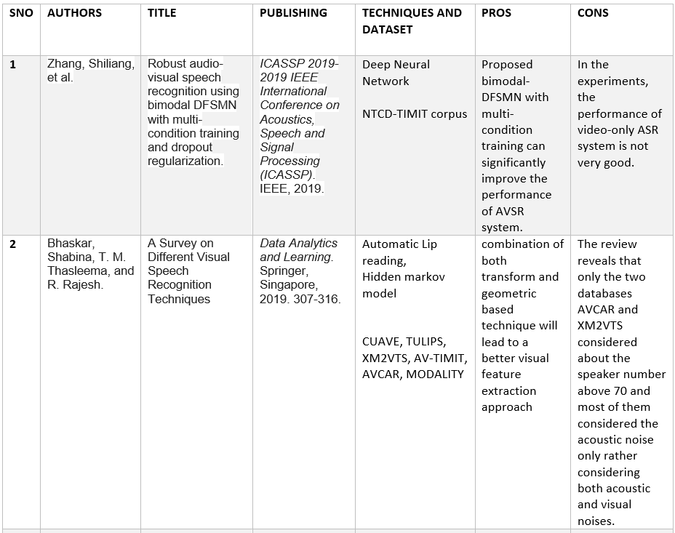
LITERATURE SURVEY

Slide 5
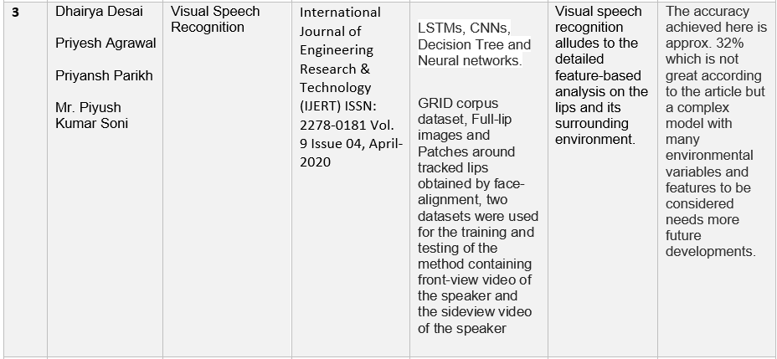

Slide 6
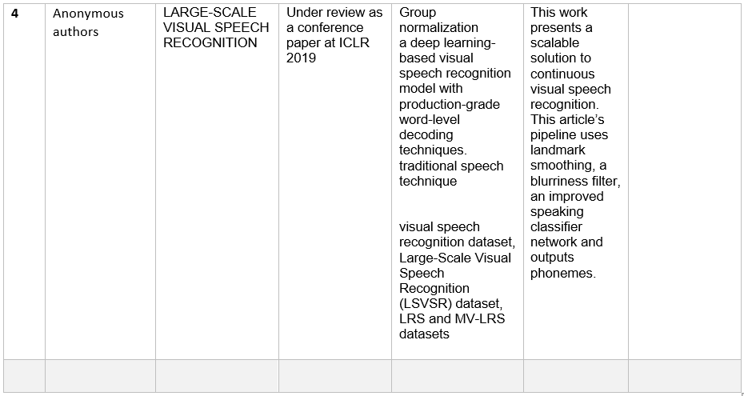

Slide 7
PROBLEM STATEMENT
Patients who are discharged from hospital without the ability to speak, or with poor speech quality, face a multitude of challenges in day-to-day life which limits their independence, social functioning and ability to seek employment.
Audio - Visual speech recognition could positively impact the lives of hundreds of thousands of patients with speech impairments worldwide.

Slide 8
CONCLUSION
to improved hearing aids and biometric authentication.
Visual speech recognition is considered to be one of the most futuristic applications of AI.
So far, there haven’t been major breakthroughs, and the domain is slowly catching up to audio-based speech recognition.
Audio - Visual speech recognition provides machines with the ability to understand languages in noisy environments and can also be used for applications related to improved hearing aids and biometric authentication.

Slide 9
SUGGESTIONS

Slide 10
THANK YOU

